Slide 1


DEPARTMENT OF ELECTRONICS AND COMMUNICATION ENGINEERING
18ECP105L-MINOR PROJECT- III FRIST REVIEW TITLE :WIRELESS LOCKING SYSTEM THROUGH OTP YEAR/SEMESTER-III/V BATCH NUMBER: 13 DATE:28/09/2024
GUIDED BY:
Mrs.L.Kavitha , M.E
AP/ECE
PRESENTED BY: K.Ashwitha P.K.Dharshana M.Elakkiyaa

Slide 2
CONTENT
Objectives
Literature Survey
Abstract
Block diagram of proposed system
Circuit diagram of proposed system
Workplan
Reference

Slide 3
OBJECTIVES
The main aim for providing locks for our home, school, office etc is for security of our lives and property. With the advancement of technology and increase the use of IOT automatic door lock system has become a standard feature on many different types of buildings and homes. And they are become popular every day to develop electronic devices which provide security
Home security has been a major issue because of the increase in crime rate and everyday wants to take proper action to prevent unauthorized user so we propose an OTP based smart wireless lock system to enhance the security of digital door- locks

Slide 4
LITERATURE SURVEY
Pradnya R. Nehete, J. P. Chaudhari,S. R. Pachpande[1] have proposed door lock systems based on Biometrics Techniques and Password Based Systems are studied and their problems and as per their knowledge, not a single system is suitable for all types of applications. Day by day technologies are developing and techniques of robbery are also developing. So, need is to develop a new smart and unbreakable technique in further studies

Slide 5
ABSTRACT
A wireless locking system that uses One-Time Passwords (OTPs) for enhanced security. By combining wireless technology with OTPs, the system allows users to unlock doors remotely using unique, temporary codes. This approach significantly reduces the risk of unauthorized access compared to traditional locks.
The system is user-friendly, enabling easy management through smartphones or web applications, making it ideal for homes and businesses. We discuss how this innovative locking system improves security and convenience, showcasing its potential in today’s digital age. Overall, wireless locking systems using OTPs represent a modern solution to access control challenges.

Slide 6








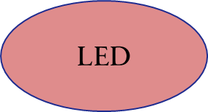
BLOCK DIAGRAM

Slide 7
PROPOSED METHOD
Our goal is to design a solution for secure access control that can replace physical keys for accessing door. We propose a solution using OTP based on smart phones providing wireless and automatic unlocking via Bluetooth
The design will allow easy implementation and the device will work autonomously. This will enhance the security and will eliminate the need of carrying physical keys

Slide 8
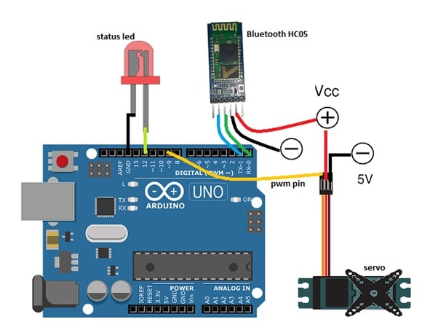
CIRCUIT DIAGRAM

Slide 9
Uses of components
1.Arduino Uno
Function: Acts as the central microcontroller for the locking system.
Role: It processes incoming OTPs, controls the servo motor for locking/unlocking, and manages communication with the Bluetooth module and other components.
2. Bluetooth HC-05
Function: Provides wireless communication between the Arduino and a smartphone or other Bluetooth-enabled devices.
Role: Receives the OTP from the mobile app or device and transmits it to the Arduino for verification.
3. Jumper Wires
Function: Facilitate electrical connections between the Arduino, Bluetooth module, servo motor, and other components.
Role: Ensure proper connectivity and signal transfer, allowing the system to function effectively.

Slide 10
4. Servo Motor
Function: Mechanically operates the locking mechanism (locking or unlocking the door).
Role: Controlled by the Arduino, the servo motor rotates to engage or disengage the lock based on the verified OTP.
5. LED
Function: Provides visual feedback during operation.
Role: Can be used to indicate the status of the system (e.g., green LED for successful unlocking, red LED for failure or incorrect OTP).
6. Power Bank
Function: Supplies portable power to the entire locking system.
Role: Ensures that the system operates independently without needing a constant AC power source, making it suitable for various installation environments.

Slide 11
Working plan
1.Requirements Gathering
Functional Requirements:
User registration and management.
OTP generation and validation.
Lock/unlock mechanism via mobile app or web interface.
Non-Functional Requirements:
Security (encryption standards).
Reliability and availability.
User-friendly interface.
2. System Design
Architecture:
Choose between a centralized or decentralized system.
Define components: mobile app, server, locking mechanism, communication protocol (e.g., Bluetooth, Wi-Fi).
Database Design:
User data storage (email, phone number, hashed passwords).
OTP storage and expiration logic.

Slide 12
3.Technology Stack
Hardware:
Wireless locking mechanism (smart lock).
Microcontroller (e.g., Arduino, Raspberry Pi) for interfacing.
Software:
Mobile application (Android/iOS).
Backend server (Node.js, Python).
Database (MySQL, MongoDB).
OTP Generation:
Use libraries like Twilio or Authy for OTP generation and delivery
4. Deployment
Pilot Deployment: Deploy in a controlled environment to monitor performance.
Full Deployment: Roll out the system to all users after addressing issues found in the pilot.

Slide 13
5.Development Phases
Phase 1: Prototyping:
Develop a basic version of the locking mechanism.
Create a simple mobile app for OTP request and lock/unlock functionalities.
Phase 2: Backend Development:
Implement user registration, OTP generation, and validation.
Set up database and server.
Phase 3: Integration:
Connect the mobile app with the backend.
Ensure communication between the mobile app and the lock.
6. Testing
Unit Testing: Test individual components (backend, app, locking mechanism).
Integration Testing: Ensure all components work together.
User Acceptance Testing: Conduct testing with potential users for feedback.

Slide 14
REFERENCE
OTP BASED SMART WIRELESS LOCK SYSTEM USING ARDUINO BY Ashwini Kumar Singh.
Elins Journal, Elins International Journal of Science Engineering & Management (EIJSEM), Volume-2, Issue-1, Jan 2017.Secure Electronic Lock Based On Bluetooth Based OTP System Available. https://www.ripublication.com/irph/ijert19/ijertv12n11 02.pdf
Neelam Majgaonkar, Ruhina Hodekar, Priyanka Bandagale, "Automatic Door Locking System", International Journal of Engineering Development and Research.
A design of OTP BASED WIRELESS SMART LOCKING SYSTEM BY MR.L.DavidWilliamraj,M.Deepika, https://www.researchgate.net/publication/32738821

Slide 15
THANK YOU

